Slide 1

Virtual PTO Meeting
Tuesday, November 2
6:30pm
Join Via WebEx
Join WebEx meeting
Meeting number/Access Code: 2318 417 7347
Meeting password: 7euPnUtKg72
Join by phone
+1-415-655-0002 US Toll
+1-904-900-2303 United States Toll (Jacksonville)

Slide 2
Agenda
OES PTO MEETING 2021
Welcome
Standing Agenda
Guest Speaker: Donnie Hopper
Foundation: Samantha Richardson
President’s Report: Michele Hildebrand
Treasurer’s Report: Janet Blanco
Principal’s Report: Mrs. Grecsek
Teachers Report: Tiffany Brown & Cynthia Thompson
Open Discussion
Next PTO Meeting: February 9th
Adjournment

Slide 3
Standing Agenda
OES PTO MEETING 2021
2021-2022 PTO Officers
  Michele Hildebrand – President
  Jeannette Blaustein –Vice –President
  Janet Blanco – Treasure
  Aimee Aubry -- Secretary
Communication
  Facebook- OES Families, please “Like” us
  Administration school Facebook page--Oasis Elementary South
  Parent Square and Panther Press
  PTO Rocks on the website

Slide 4
Oasis Middle School Principal
Guest Speaker:
Mr. Donnie Hopper

Slide 5
Foundation
Lighthouse Award’s
Nomination going on now.
.
WINNERS WILL BE ANNOUNCED AT THE LIGHTHOUSE AWARDS DINNER ON SUNDAY, MARCH 6, 2022

Slide 6
President’s Report
Past Events
  Trunk or Treat
  Staff/Teacher Appreciation has been busy
    Halloween
Upcoming Events
  Holiday Event
  Frosty’ s Factory
  Veterans Day Bulletin Board
New Business
  Frosty’s Factory
Old Business
  Box Tops

Slide 7


Slide 8
Trunk or Treat Winners
Pictures on OES Families on Facebook!
First place - Camerons’s class with their Coco theme (96 votes).
Second place - Taylor (4th grade) with their haunted house (32 votes).
Third place - Feury with their Addams Family theme (31 votes).
Close runner ups were Taylor (1st) with Candyland and Lucas with Harry Potter, both with 29 votes.

Slide 9
Teacher Costume Winners
Pictures on OES Families on Facebook!
First place - 3rd Grade with - Jurassic Park
Second place - 1st Grade with - Thanksgiving dinner
Third place - Kindergarten - Cruella and her Dalmations.

Slide 10
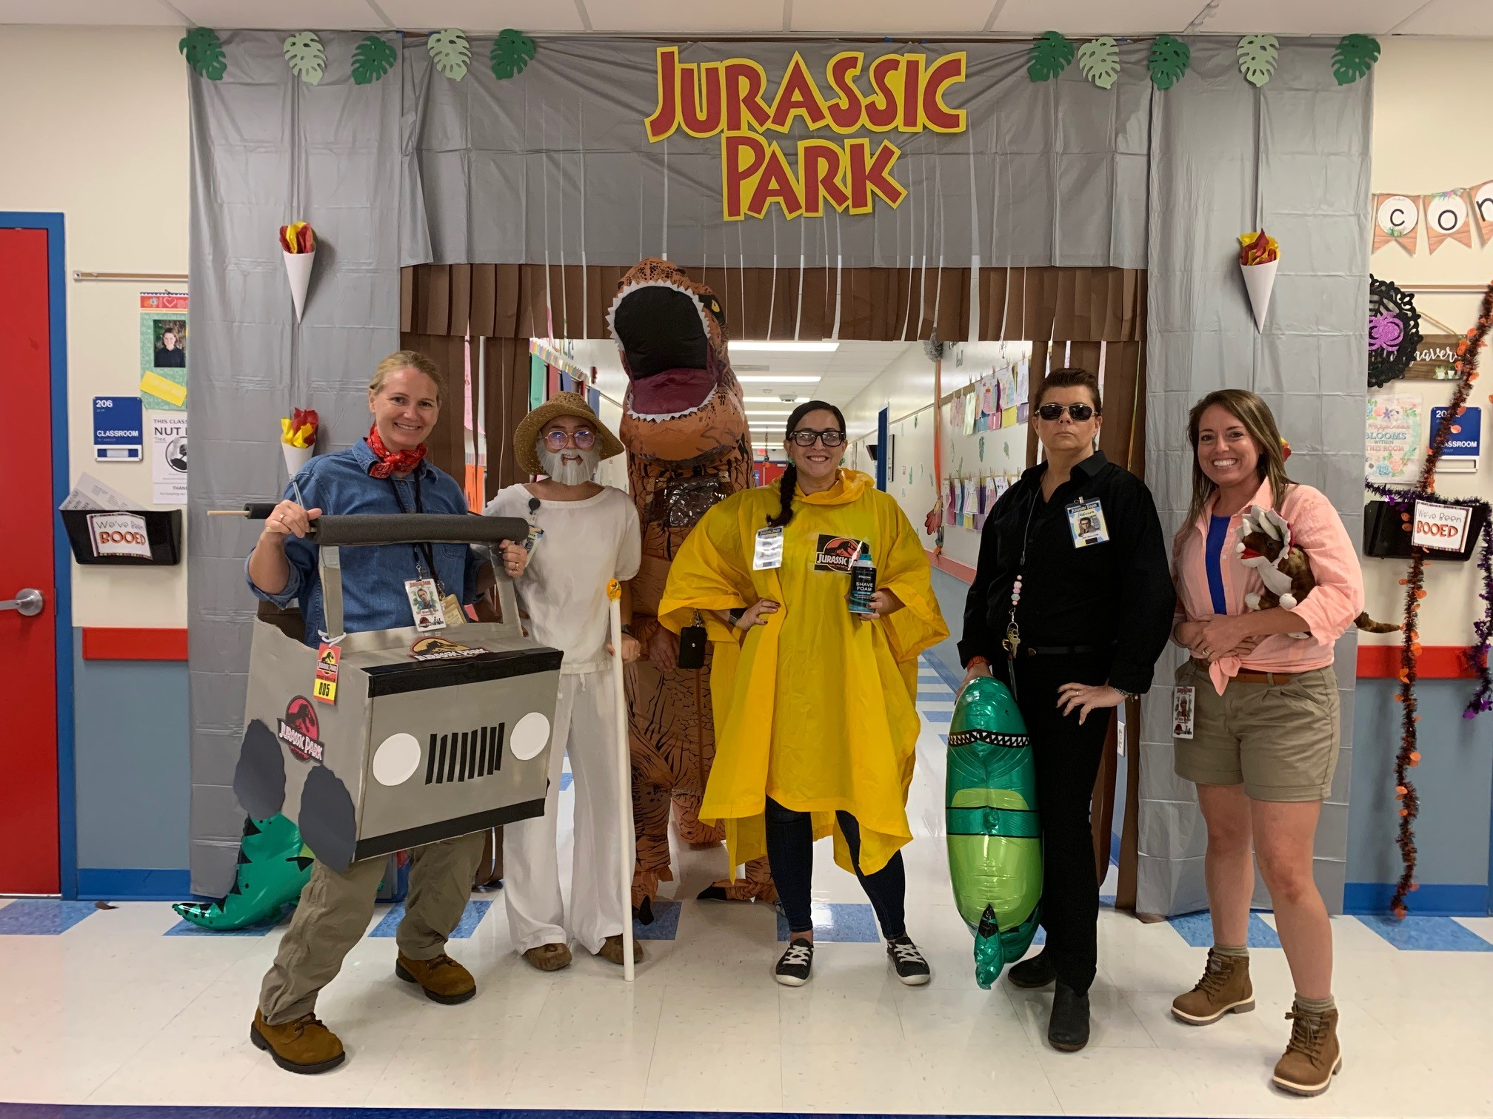
First place - 3rd Grade with - Jurassic Park

Slide 11
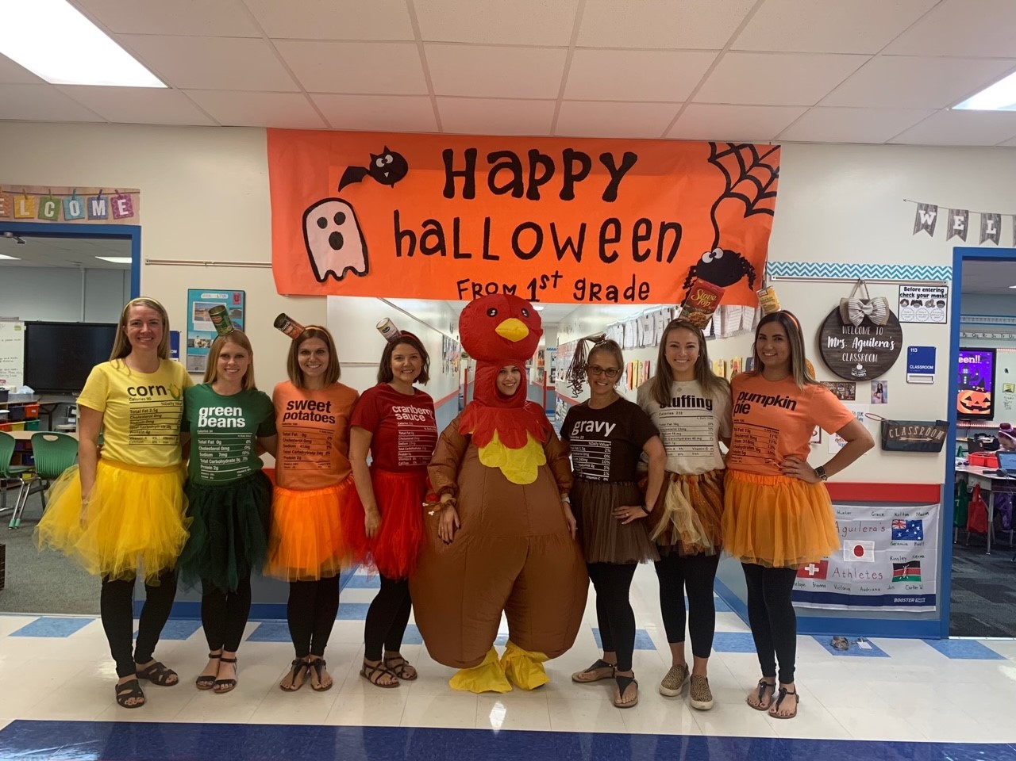
Second place - 1st Grade with - Thanksgiving dinner

Slide 12
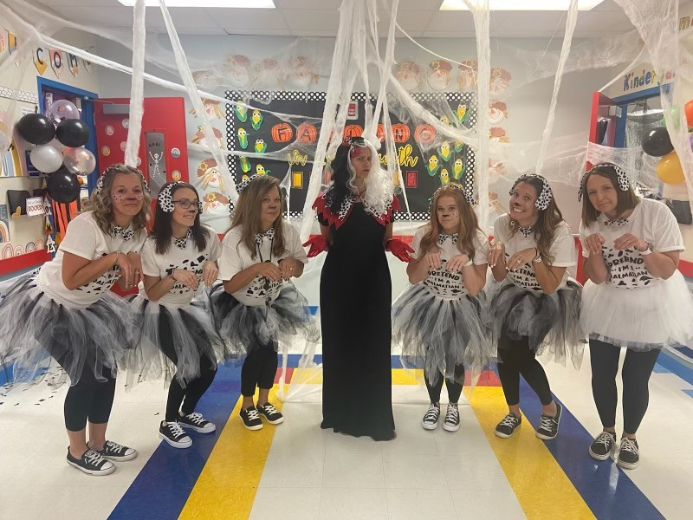
Third place - Kindergarten - Cruella and her Dalmations

Slide 13
Holiday Event

Slide 14
Cookies with Santa
3rd Grade Committee Event is HOLIDAY EVENT
Timeframe: December, 11th
9:30am - 12:00pm
Members: Phoenix Proffitt, Ganna Gaber, Amanda Rourke, Stephanie Rochelle, Christine Baron

Slide 15
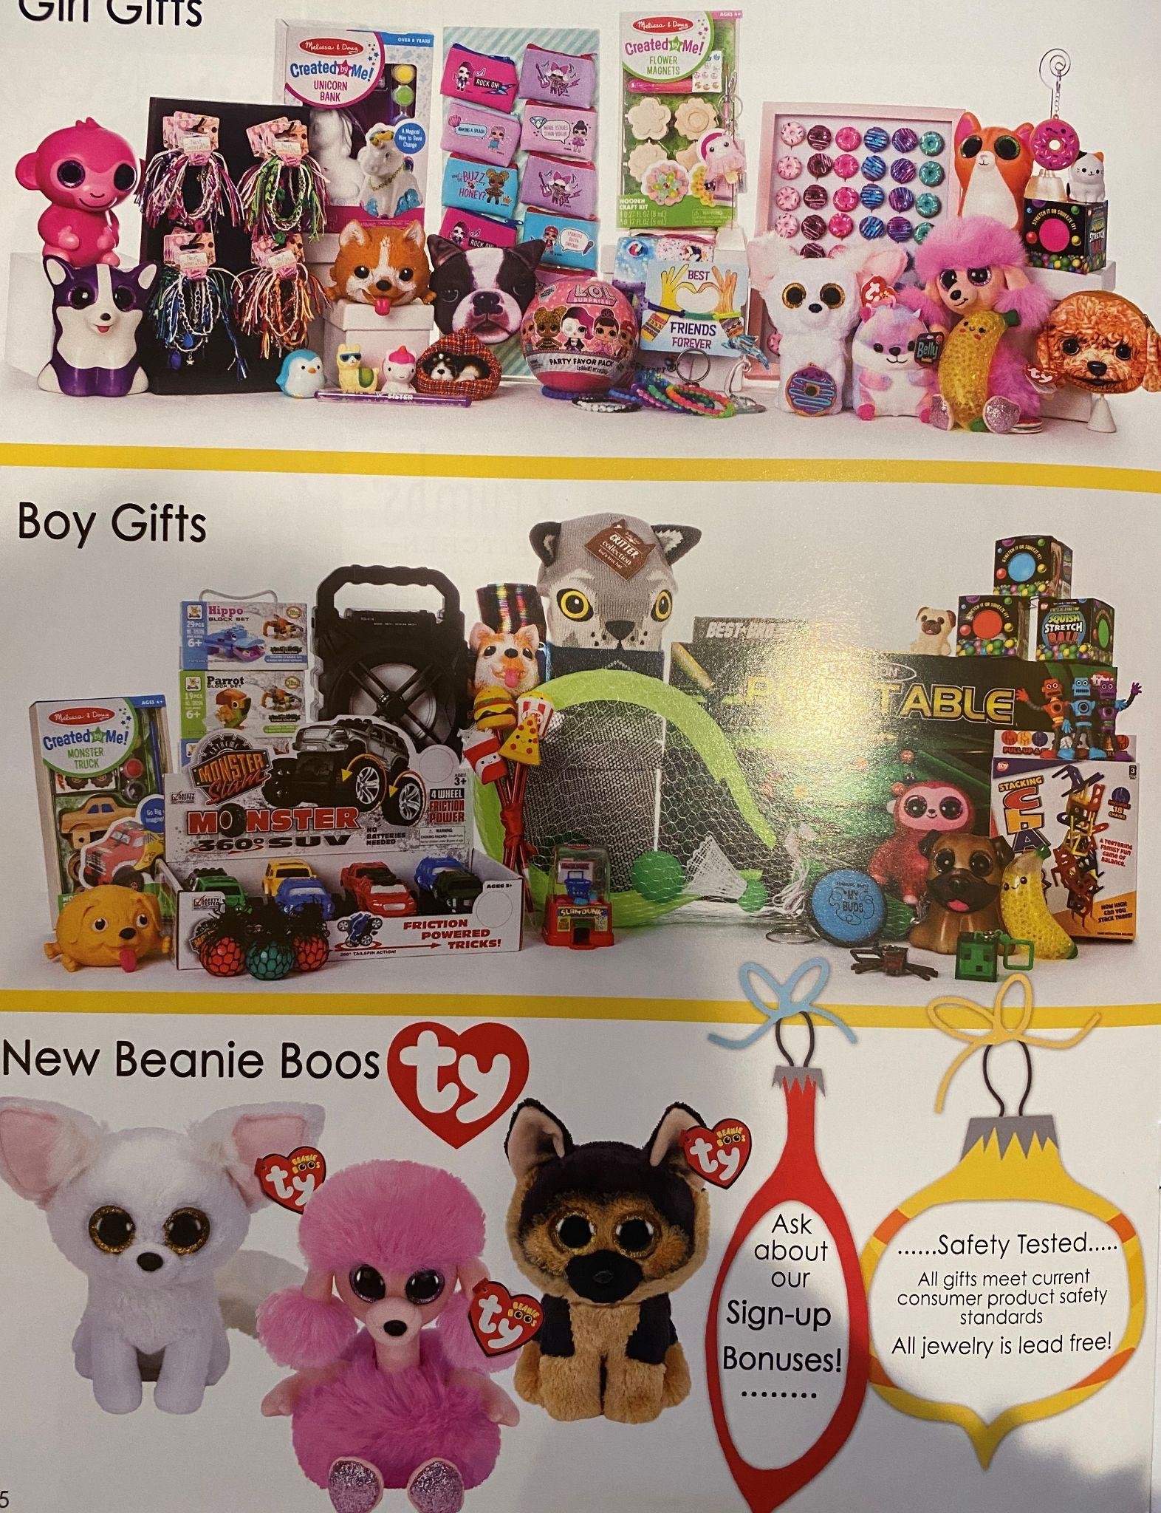
Frosty Factory
Wonderland Gift Shoppes is the company we are using this year.
We will need volunteers for set up on Dec 1st and also 2 to 3 volunteers per shift daily to run the store during the week.
We will also need volunteers during Cookies with Santa and for take down.
Please look for sign up genius to sign up.

Slide 16
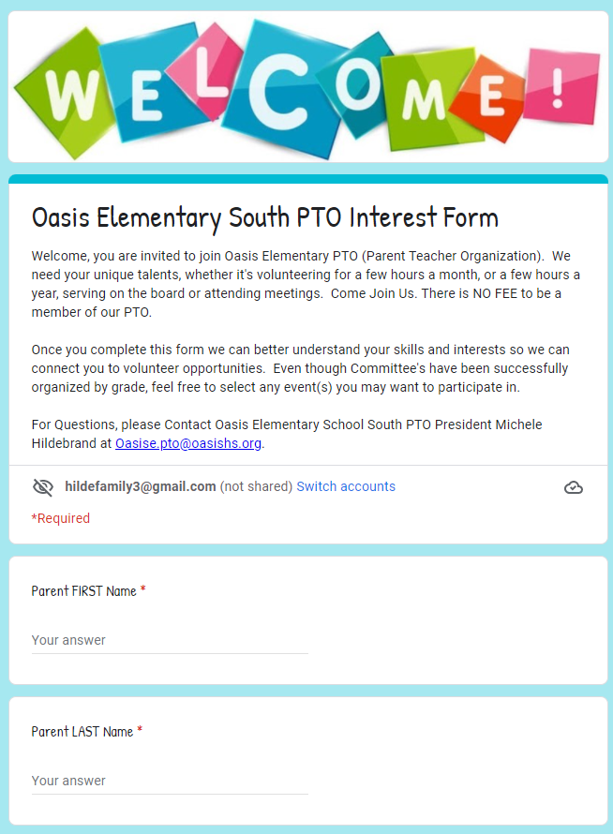
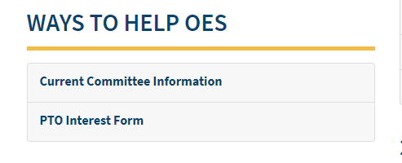
Committee Leads
On the PTO Rocks:

Slide 17
Old Business

Slide 18
Box Tops

Slide 19


Slide 20
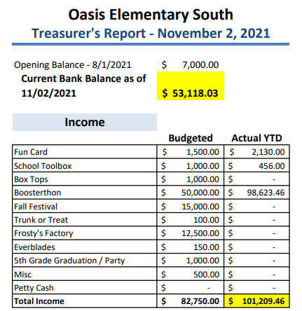
Treasurer’s Report
- November 02, 2021
Income

Slide 21
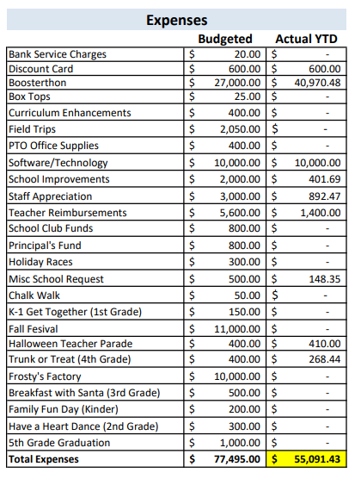
Treasurer’s Report
- November 2, 2021
Expenses

Slide 22
Principal’s Report
Pending

Slide 23
Teacher Report
Tiffany Brown K-2
Update
Cynthia Thompson 3-5
Update

Slide 24
Open Discussion

Slide 25
Next PTO Meeting: February 9th, 2022
Thank You!

Slide 26
Fall Festival
Could become a Spring Festival

Slide 27
Agenda
OES PTO MEETING 2021
Welcome
Standing Agenda
Guest Speaker: Mr. Hopper
Foundation:
President’s Report: Michele Hildebrand
Treasurer’s Report: Janet Blanco
Principal’s Report: Mrs. Grecsek
Teachers Report: Tiffany Brown & Cynthia Thompson
Open Discussion
Next PTO Meeting: February 9th
Adjournment

Slide 28
Committee Leads
We plan to continue to have our "Family Fun" Events organized by different grade levels. Please consider getting involved!
Kindergarten Committee FAMILY FUN EVENT
Timeframe: Spring
Members: Yosniel Vento, Lianet Morejon, Ganna Gaber, Erin Wilson, Stephanie Rochelle, Jami Kolev, Christine Baron
1st Grade Committee FAMILY DANCE
Timeframe: February/March
Members: Autumn Clark, Karoline Fabril, Amanda Rourke, Jelena Cianchetta
2nd Grade Committee Event is BOO HOO BREAKFAST & KINDER WELCOME COMMITTEE
Timeframe: Summer & August
Members: Amanda Rourke, Christine Baron
3rd Grade Committee Event is HOLIDAY EVENT
Timeframe: December
Members: Phoenix Proffitt, Ganna Gaber, Amanda Rourke, Stephanie Rochelle, Christine Baron
4th Grade Committee Event is TRUNK OR TREAT
Timeframe: October
Members: Mara Brown & Lindsey Zimmerman
5th Grade Committee Event is the MOVING UP PARTY
Timeframe: May/June
Members: Heather Dinkle, Sam Richardson, Janielle Marrero

