Slide 1

Oasis Elementary
SAC Meeting
November 6, 2018

Slide 2
2018-2019 Goals
Science
  Increase Proficiency by 2%
    From 68 to 70
ELA
  Increase Proficiency by 2%
    From 75 to 77
  Increase Learning Gains by 2%
    From 63 to 65
  Increase L25 Learning Gains by 3%
    From 62-65

Slide 3
2018-2019 Goals
Math
  Increase Proficiency by 2%
    From 79 to 81
  Increase Learning Gains by 2%
    From 67 to 69
  Increase L25 Learning Gains by 3%
    From 58 to 61

Slide 4
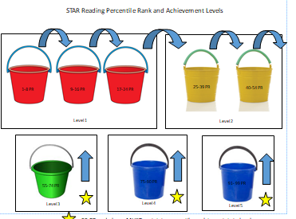
Review: STAR/FSA ELA Buckets

Slide 5
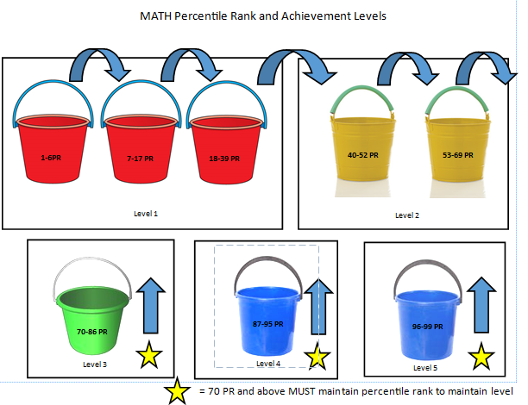
Review:STAR/FSA Math Buckets

Slide 6
October Data-Grade KG
STAR RDG
STAR Level | Aug STAR | Oct STAR
1a (0-8%) | 11 | 5
1b (9-16%) | 16 | 4
1c (17-24%) | 8 | 6
2a (25-39%) | 19 | 10
2b (40-54%) | 16 | 18
3 (55-74%) | 35 | 38
4 (75-90%) | 26 | 32
5 (91-99%) | 8 | 25
Total L3+ | 50% | 69%

Slide 7
October Data-Grade 01
STAR RDG STARMath
STAR Level | Aug STAR | Oct STAR
1a (0-8%) | 2 | 2
1b (9-16%) | 4 | 0
1c (17-24%) | 6 | 0
2a (25-39%) | 21 | 10
2b (40-54%) | 22 | 14
3 (55-74%) | 33 | 29
4 (75-90%) | 26 | 38
5 (91-99%) | 22 | 45
Total L3+ | 60% | 81%
STAR Level | Aug STAR | Oct STAR
1a (0-6%) | 7 | 0
1b (7-17%) | 6 | 1
1c (18-39%) | 17 | 6
2a (40-52%) | 24 | 3
2b (53-69%) | 29 | 23
3 (70-86%) | 32 | 48
4 (87-95%) | 13 | 36
5 (96-99%) | 8 | 22
Total L3+ | 39% | 76%

Slide 8
October Data-Grade 02
STAR RDG STAR MATH
STAR Level | Aug STAR | Oct STAR
1a (0-8%) | 0 | 0
1b (9-16%) | 5 | 0
1c (17-24%) | 6 | 0
2a (25-39%) | 19 | 3
2b (40-54%) | 11 | 12
3 (55-74%) | 41 | 35
4 (75-90%) | 35 | 50
5 (91-99%) | 21 | 33
Total L3+ | 70% | 89%
STAR Level | Aug STAR | Oct STAR
1a (0-6%) | 1 | 0
1b (7-17%) | 4 | 1
1c (18-39%) | 23 | 9
2a (40-52%) | 20 | 11
2b (53-69%) | 30 | 26
3 (70-86%) | 34 | 43
4 (87-95%) | 14 | 30
5 (96-99%) | 10 | 19
Total L3+ | 43% | 66%

Slide 9
October Data-Grade 03
STAR RDG STAR MATH
STAR Level | Aug STAR | Oct STAR
1a (0-8%) | 0 | 0
1b (9-16%) | 4 | 0
1c (17-24%) | 10 | 0
2a (25-39%) | 16 | 10
2b (40-54%) | 22 | 16
3 (55-74%) | 43 | 43
4 (75-90%) | 36 | 54
5 (91-99%) | 10 | 17
Total L3+ | 63% | 81%
STAR Level | Aug STAR | Oct STAR
1a (0-6%) | 0 | 0
1b (7-17%) | 2 | 1
1c (18-39%) | 16 | 7
2a (40-52%) | 18 | 8
2b (53-69%) | 30 | 20
3 (70-86%) | 43 | 38
4 (87-95%) | 25 | 47
5 (96-99%) | 7 | 18
Total L3+ | 53% | 74%

Slide 10
October Data-Grade 04
STAR RDG STAR MATH
STAR Level | Aug STAR | Oct STAR
1a (0-8%) | 0 | 0
1b (9-16%) | 3 | 2
1c (17-24%) | 2 | 2
2a (25-39%) | 21 | 10
2b (40-54%) | 22 | 21
3 (55-74%) | 31 | 27
4 (75-90%) | 39 | 43
5 (91-99%) | 25 | 34
Total L3+ | 66% | 75%
STAR Level | Aug STAR | Oct STAR
1a (0-6%) | 0 | 0
1b (7-17%) | 2 | 2
1c (18-39%) | 15 | 7
2a (40-52%) | 12 | 10
2b (53-69%) | 28 | 24
3 (70-86%) | 34 | 35
4 (87-95%) | 25 | 36
5 (96-99%) | 25 | 28
Total L3+ | 59% | 70%

Slide 11
October Data-Grade 05
STAR RDG STAR MATH
STAR Level | Aug STAR | Oct STAR
1a (0-8%) | 1 | 1
1b (9-16%) | 3 | 1
1c (17-24%) | 3 | 6
2a (25-39%) | 27 | 15
2b (40-54%) | 31 | 32
3 (55-74%) | 45 | 40
4 (75-90%) | 32 | 36
5 (91-99%) | 2 | 11
Total L3+ | 55% | 61%
STAR Level | Aug STAR | Oct STAR
1a (0-6%) | 0 | 1
1b (7-17%) | 4 | 2
1c (18-39%) | 8 | 3
2a (40-52%) | 18 | 6
2b (53-69%) | 42 | 29
3 (70-86%) | 35 | 50
4 (87-95%) | 31 | 41
5 (96-99%) | 6 | 12
Total L3+ | 50% | 72%

Slide 12
3-5 ELA Proficiency &
4 & 5 Learning Gains
ELA 3-5 Proficiency
ELA 4 & 5 Learning Gains
 | BL | Q1 | Q2 | Q3 | Q4
GR03 | 63 | 81
GR04 | 66 | 75
GR05 | 55 | 62
AVG | 61 | 73
GOAL | 77 | 77
Difference | -16 | -4
 | Q1 | Q2 | Q3 | Q4
GR04 | 70
GR05 | 56
AVG | 63
GOAL | 65
Difference | -2

Slide 13
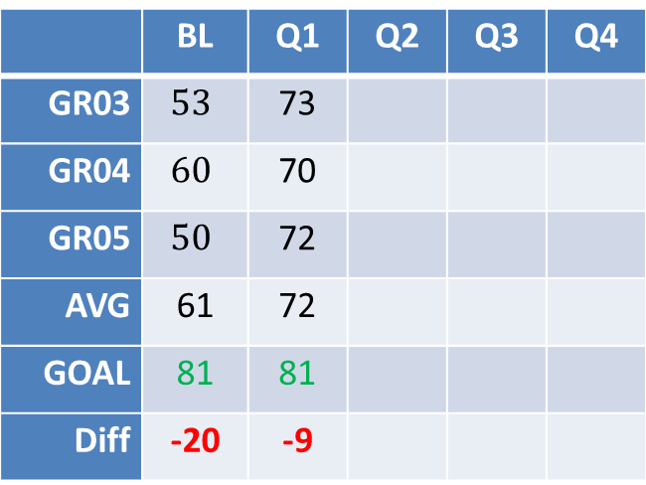
3-5 Math Proficiency &
4 & 5 Learning Gains
Math 3-5 Proficiency
Math 4 & 5 Learning Gains
 | Q1 | Q2 | Q3 | Q4
GR04 | 71
GR05 | 67
AVG | 69
GOAL | 69
Diff | +0
 | BL | Q1 | Q2 | Q3 | Q4
GR03 | $$53$$ | 73
GR04 | $$60$$ | 70
GR05 | $$50$$ | 72
AVG | 61 | 72
GOAL | 81 | 81
Diff | -20 | -9

Slide 14

Tracking our Goal Progress
 | ELA Achievement | ELA Learning Gains | ELA Learning Gains of the Lowest 25% | Math Achievement | Math Learning Gains | Math Learning Gains of the Lowest 25% | Science Achievement | Total Points
17.18 FSA Results | 75 | 63 | 62 | 79 | 67 | 58 | 68 | 472
18.19 GOAL | 77 | 65 | 65 | 81 | 69 | 61
October STAR | 73 | 63 |  | 72 | 69
DIFF: | -4 | -2 |  | -9 | 0

Slide 15
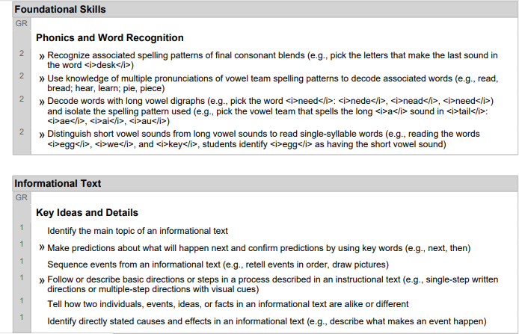
Second Quarter Instructional Plan

Slide 16
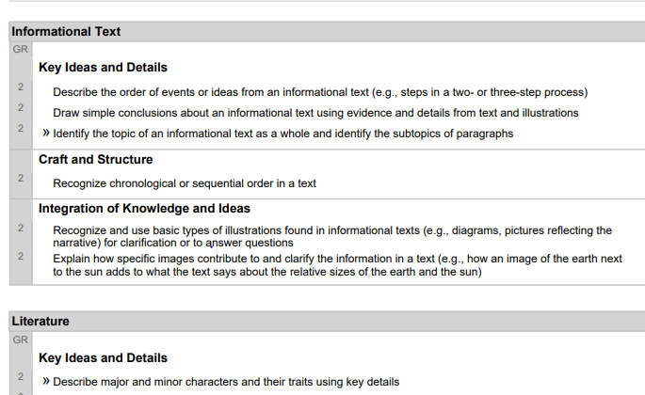
Second Quarter Instructional Plan

Slide 17

Second Quarter Plan
Purchased Moby Max for Personalized and Differentiated Learning

