Slide 1

Virtual PTO Meeting
Wednesday March 30, 2022
6:30pm
Join Via WebEx
Join WebEx meeting
Meeting number/Access Code: 2315 477 1497
Meeting password: prHf3JBRd33
Join by phone
+1-415-655-0002 US Toll
+1-904-900-2303 United States Toll (Jacksonville)

Slide 2
Agenda
OES PTO MEETING 2021/2022
Welcome
Standing Agenda
Guest Speaker: Christina Placke
Foundation: Samantha Richardson
President’s Report: Michele Hildebrand
Treasurer’s Report: Janet Blanco
Principal’s Report: Mrs. Grecsek
Teachers Report: Tiffany Brown
Open Discussion
Next PTO Meeting: May 4
Adjournment

Slide 3
Standing Agenda
OES PTO MEETING 2021/2022
2021-2022 PTO Officers
  Michele Hildebrand – President
  Jeannette Blaustein –Vice –President
  Janet Blanco – Treasure
  Aimee Aubry -- Secretary
Communication
  Facebook- OES Families, please “Like” us
  Administration school Facebook page--Oasis Elementary South
  Parent Square and Panther Press
  PTO Rocks on the website

Slide 4
Music
Guest Speaker:
Christina Placke

Slide 5

Music
at

Slide 6
The Music World
K-5 Music Class
Musical Theatre
FMEA Conference
What’s happening in class?
What can we look forward to seeing?
How is OES contributing to and benefitting from the larger world of music education?

Slide 7
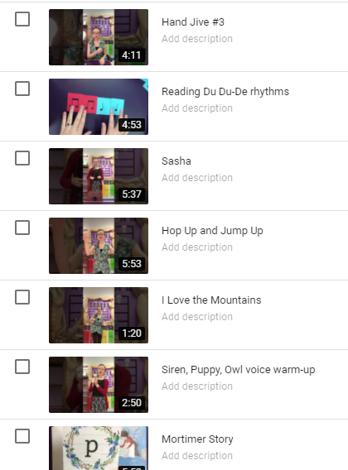
Curriculum
“Tuneful, Artful, Beatful”
Florida State Standards
First Steps in Music
Conversational Solfege
Orff
Ukulele
Movement

Slide 8
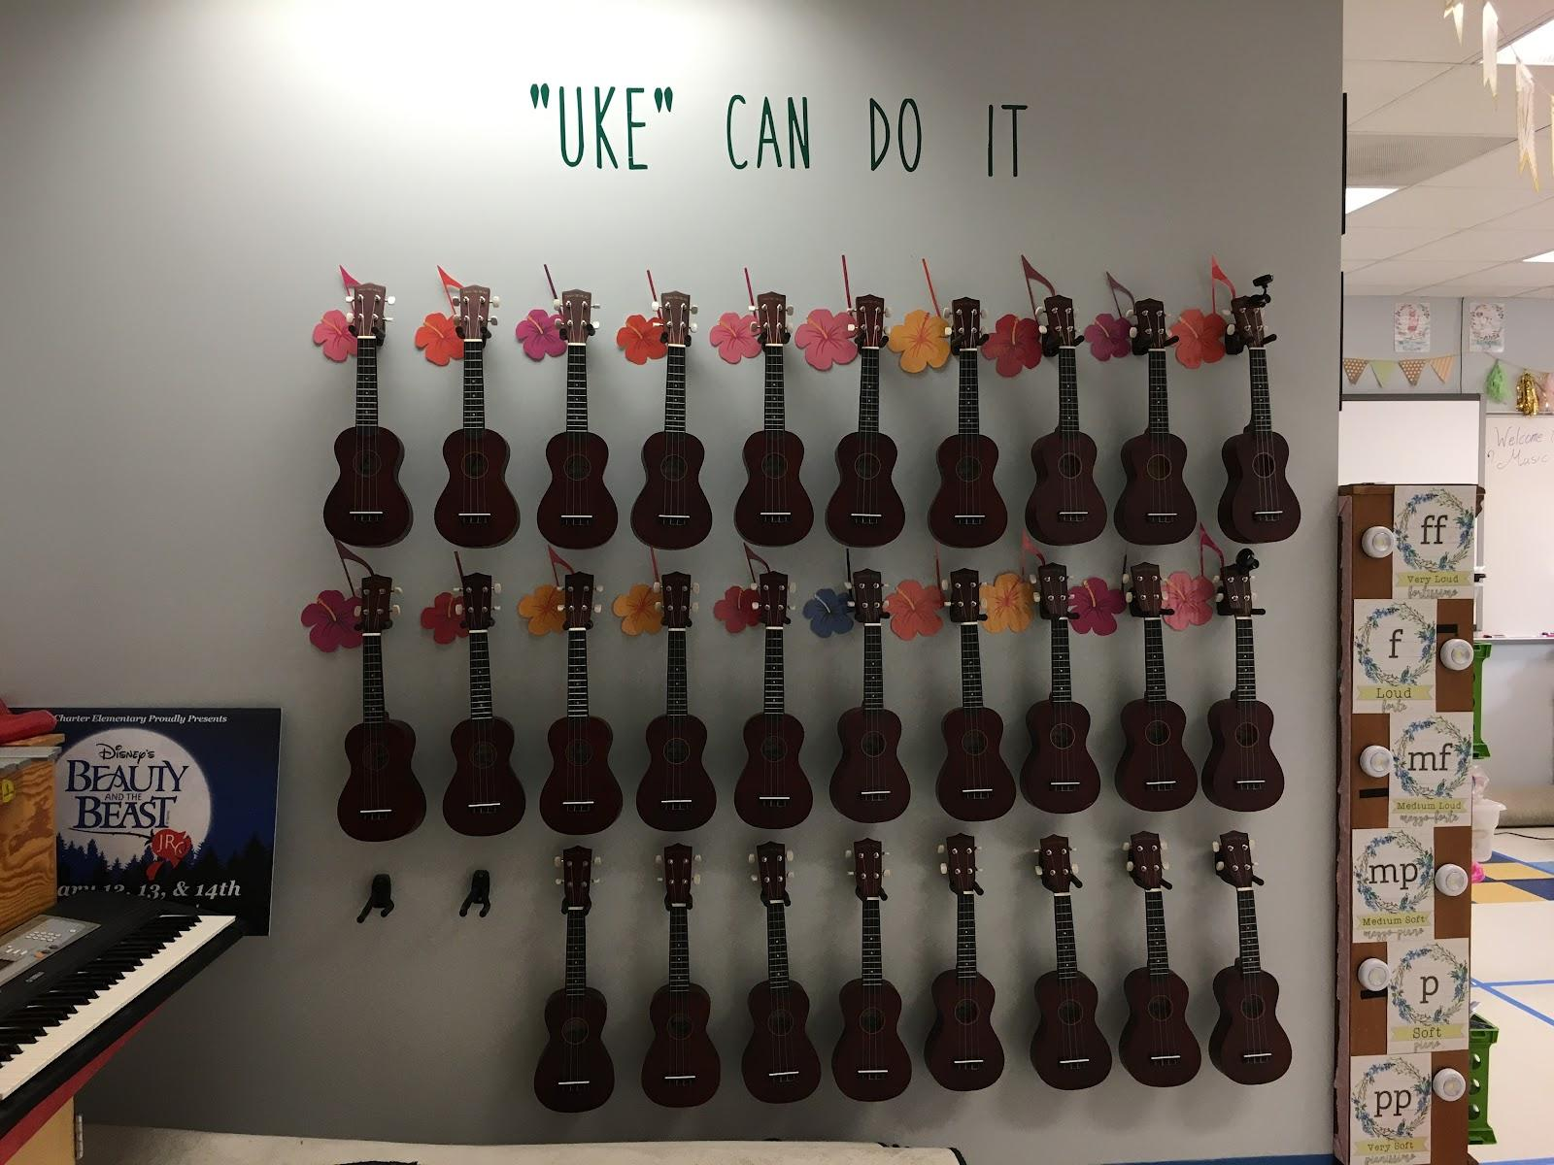
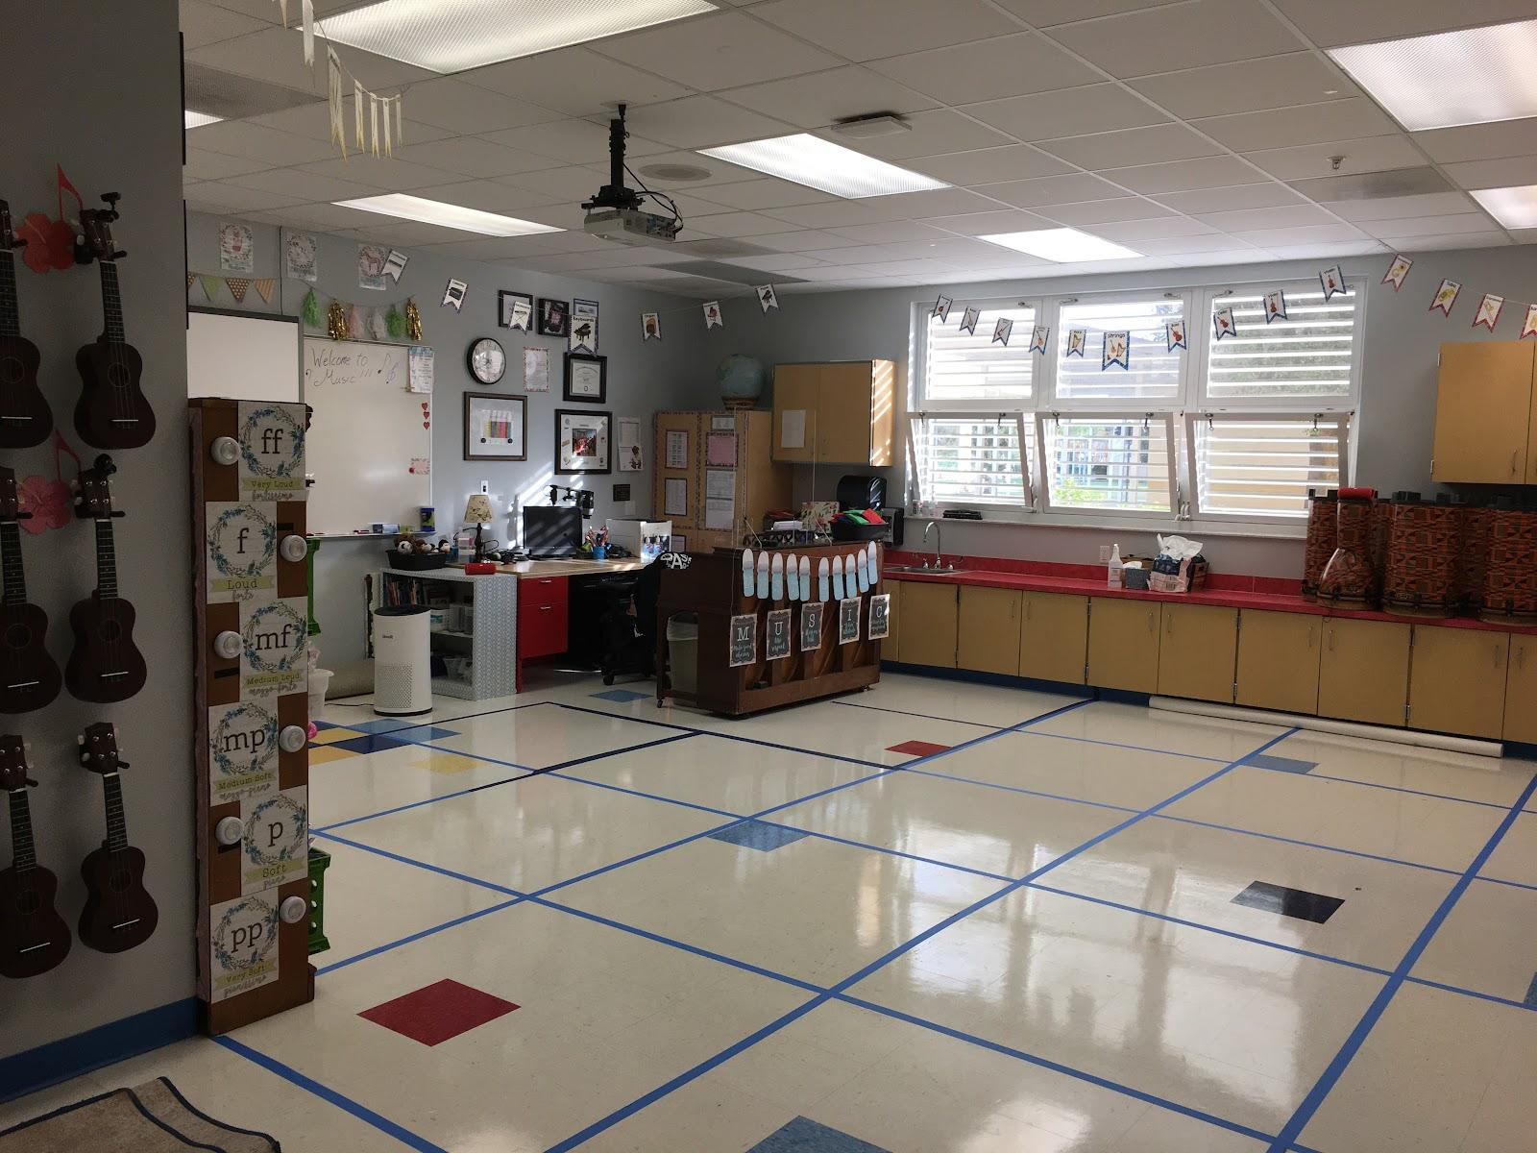
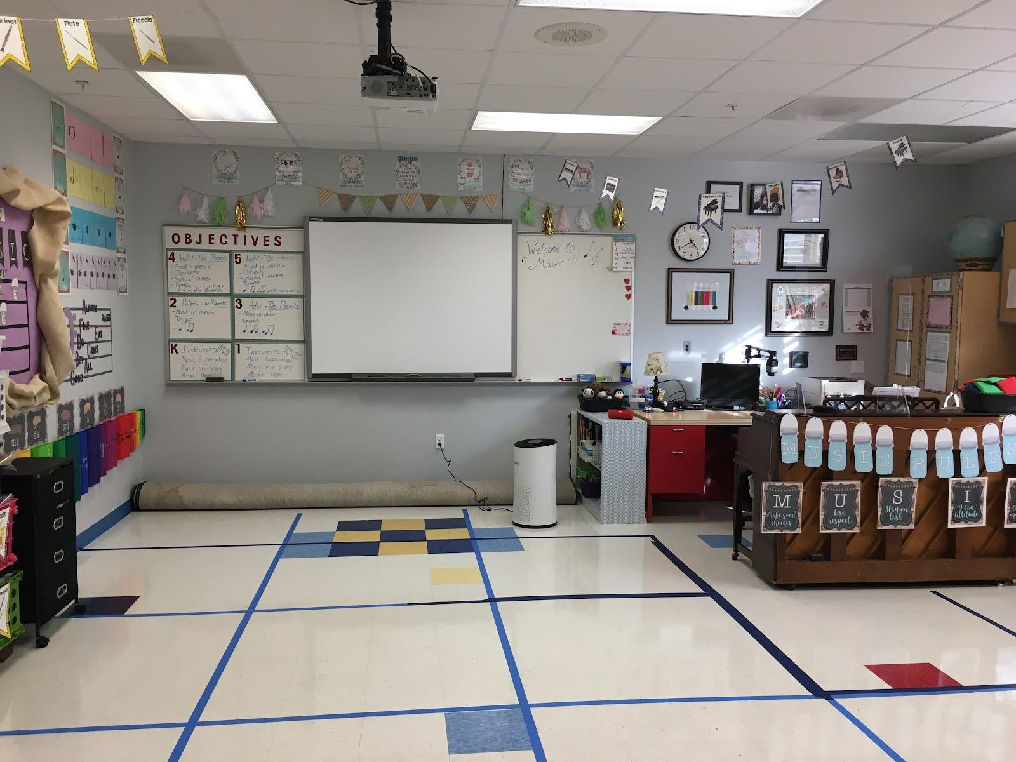
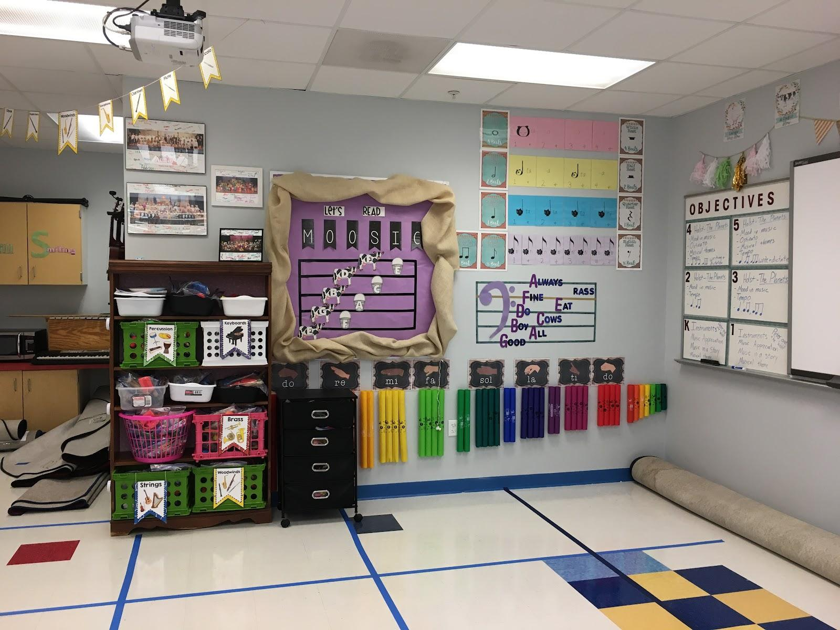
Music Classroom

Slide 9
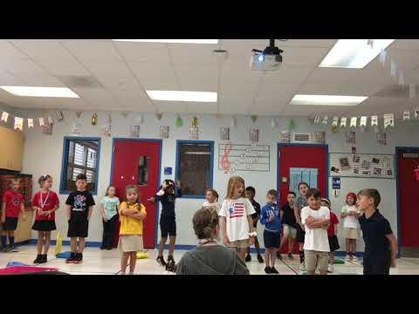
Mrs. Holowell’s First Graders
“Oh, My! No More Pie!”

Slide 10
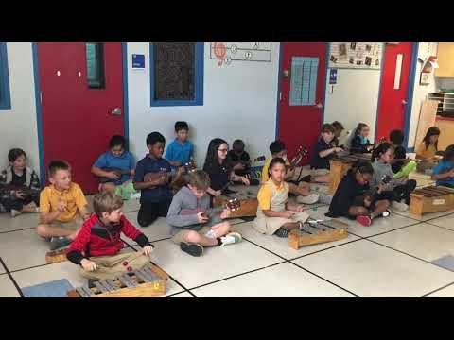
Mrs. Kraver’s 3rd Graders Playing Ukulele

Slide 11
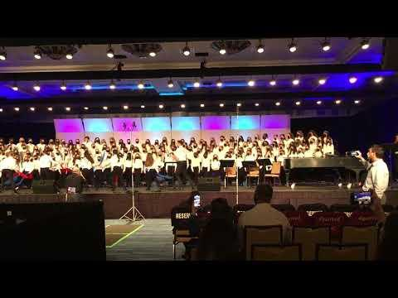
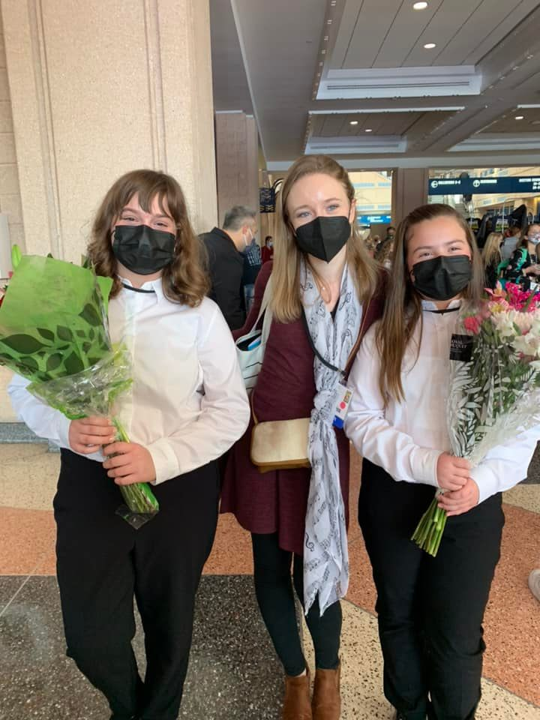

Florida Music Educators Association Conference
Membership
Conference
All-State Chorus
Membership paid for by PTO -- THANK YOU!!!
At the Tampa Convention Center Jan. 12th-14th.
Adelynn H. and Allison T. represented OES in the Elementary All-State Chorus!

Slide 12

Musical Theater

Slide 13

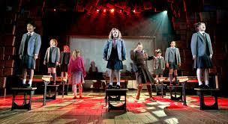


What’s new in theater
Program ads are on sale!
May 18th-20th
39 Students
Island Coast High School

Slide 14
THANK YOU!
Thank you for supporting music at Oasis Elementary South!

Slide 15

Foundation
Lighthouse Award’s
Virginia Tann
Melanie Klages
Rally On The Green
Friday April 8th
  ^{Tropical Breeze fun Park}
Saturday April 9th
  Golfing at Cape Royal Golf Club
  ^{Auction}

Slide 16
President’s Report
Past Events
  Nothing to report
Upcoming Events
  Staff/Teacher Appreciation – Spring Easter Egg Hunt April 14
  Staff/Teacher Appreciation – Appreciation week April 25th – 29th
New Business
  Spring/Summer Event
    May 23 & 24 during school
  Elections
Old Business
  Box Tops

Slide 17
PTO BOARD ELECTIONS - Interest
Board Nominations open now through May 1st.
If you are interested please email the PTO at oasise.pto@oasishs.org include a short bio and a few lines as to why you want to be on the board.
Voting will be at the May 4th PTO meeting.

Slide 18
ELECTIONS – Duties of Elected Officers
PRESIDENT:
▪ Shall preside over all PTO Board, General, and Special Meetings.
▪ Know and follow the By-Laws of the organization.
▪ Coordinate the work of the Officers and Committees, in order that the objectives of the PTO may be promoted.
▪ Assist in the preparation of an annual budget.
▪ Prepare in advance of each meeting a complete agenda showing the order in which business will be addressed at the meeting.
▪ Ensure accurate and consistent communication between the Board members.
▪ Shall oversee the PTO webmaster and website to ensure it contains updated an accurate information.
▪ Attend City of Cape Coral Charter School Governing Authority meetings when possible.
▪ Shall serve as the liaison between the PTO and the City of Cape Coral Charter School Governing Authority.
VICE PRESIDENT:
▪ Reports to the President.
▪ Performs the duties of the President in his or her absence or inability to serve.
▪ Act as a liaison between the teachers/staff and the PTO Board.
▪ Serve on the Audit committee.
▪ Shall work with the Staff Volunteer Coordinator to aid in helping PTO members earn volunteer hours.
▪ Shall be chairperson of school-wide festival (ie Fall Festival) along with the support of the entire PTO Board.
▪ Attend City of Cape Coral Charter School Governing Authority in the absence of the President when possible.

Slide 19
ELECTIONS – Duties of Elected Officers
SECRETARY:
▪ Keep a record of all correspondence.
▪ Shall oversee the PTO webmaster and website to ensure it contains updated and accurate information.
▪ Keep records of all PTO Board, General, and Special meetings.
▪ Produce a copy of the minutes within 14 days to all members of the PTO Board.
▪ Ensure that a copy of all meeting minutes, notices and letters are safe and secure including but not limited to a digital and hard copy.
▪ Compile and maintain a list of all PTO Board members, Committee chairpersons,
and active PTO members.
▪ Coordinate sign in and record keeping of all PTO General and Special Meetings.
▪ Special projects as needed.
TREASURER:
▪ Shall receive all monies from PTO functions of the school.
▪ Keep an accurate record of receipts and expenditures.
▪ Pay out funds as authorized by the PTO Board and members.
▪ Present a financial statement at every meeting of the organization and at any other time when requested by the PTO Board.
▪ Deposit all monies received in the PTO account within three (3) days of collection. Obtain a receipt for every invoice, purchase or other payment made
by the PTO when possible.
▪ Assist in preparing a proposed annual budget.
▪ Cooperate in the auditing process for the PTO books.
▪ Maintain and be responsible for Checking account and Debit Card.

Slide 20
Old Business

Slide 21
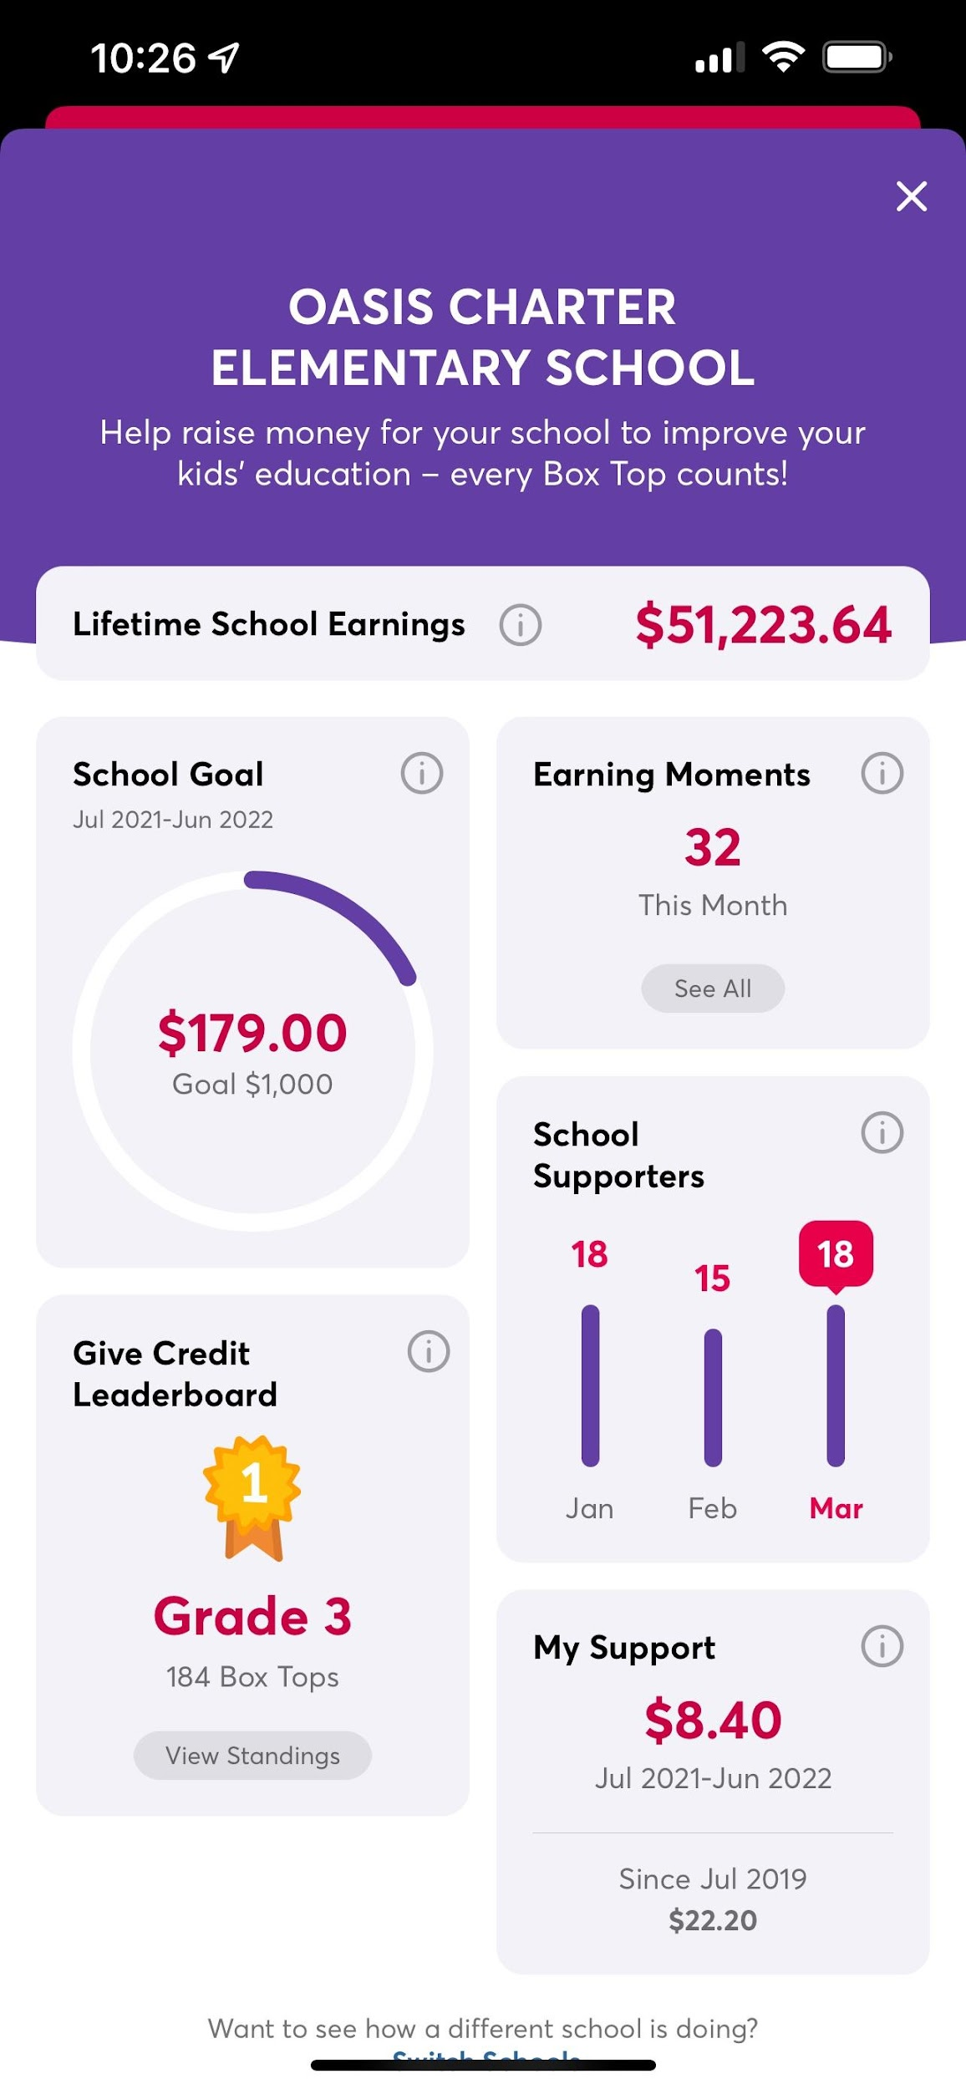
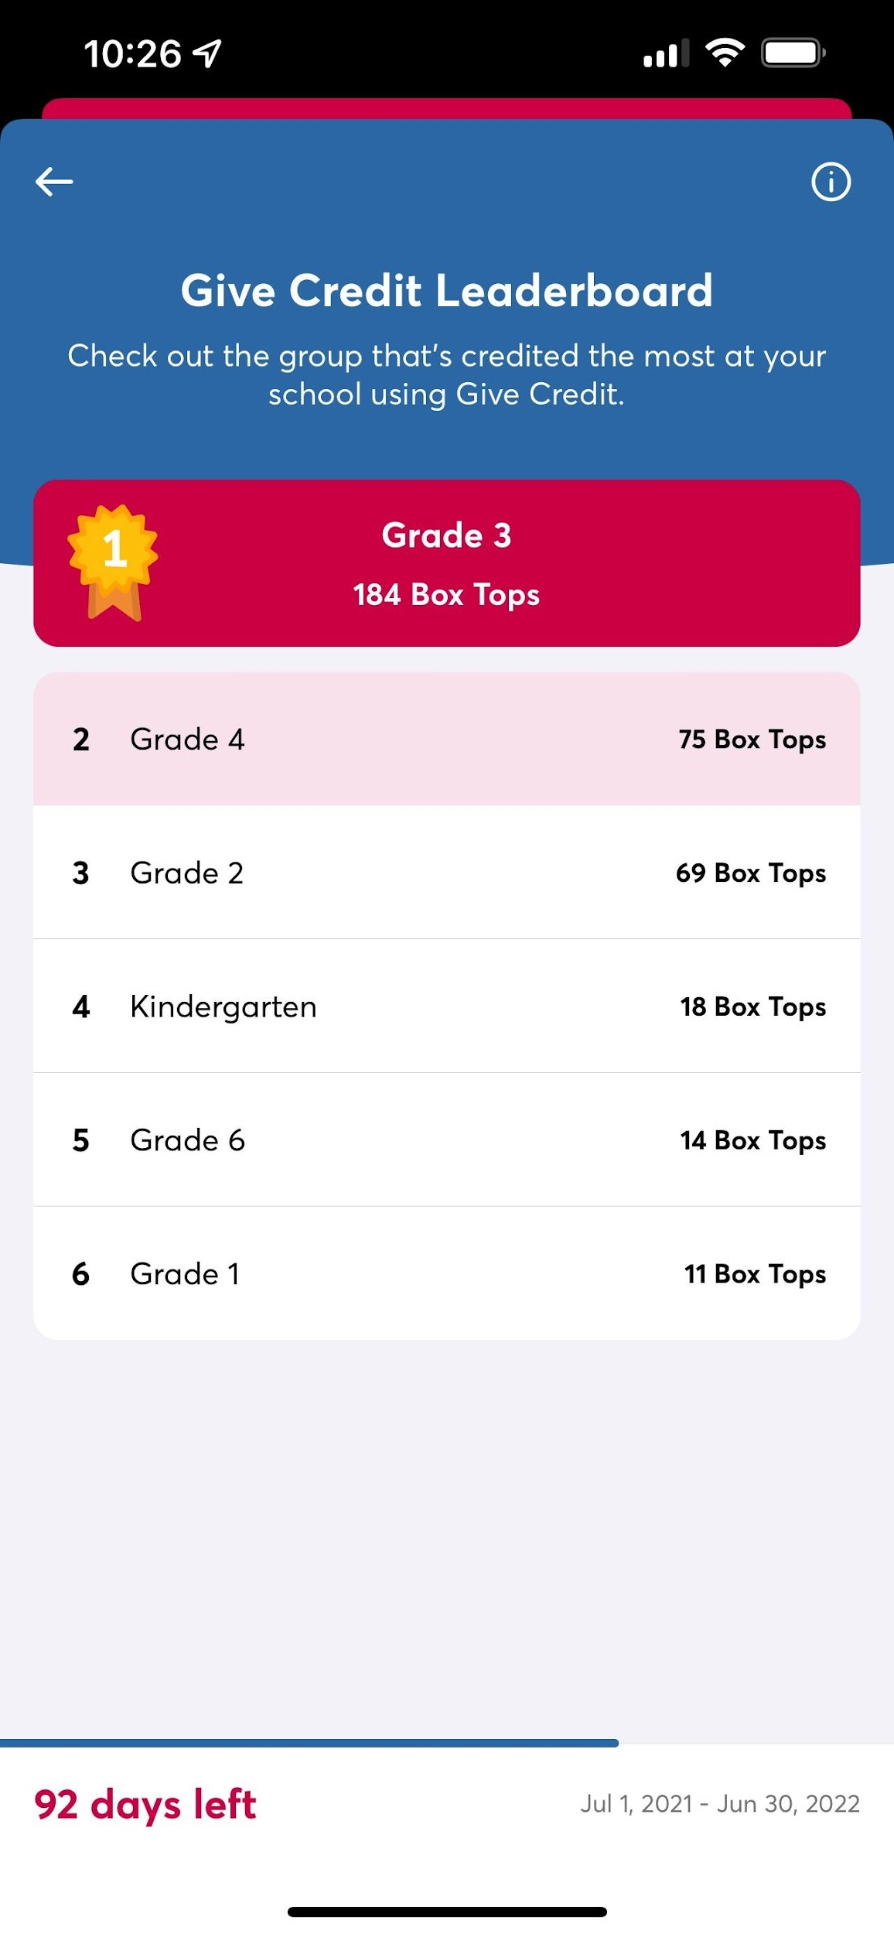
Box Tops

Slide 22

Box Tops
Popular participating products:

Slide 23


Slide 24
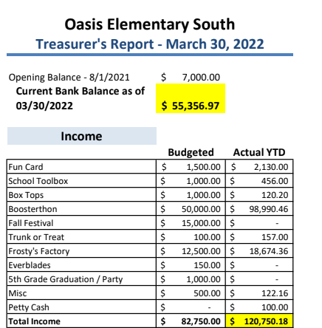
Treasurer’s Report
- March, 2022
Income

Slide 25
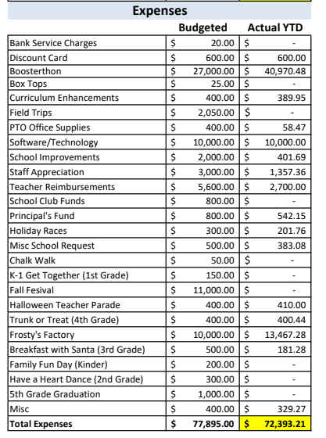
Treasurer’s Report
- March 2022
Expenses

Slide 26
Principal’s Report

Slide 27
Teacher Report
Tiffany Brown K-5
Update

Slide 28
Open Discussion

Slide 29
Next PTO Meeting: May 4, 2022
Thank You!

Slide 30
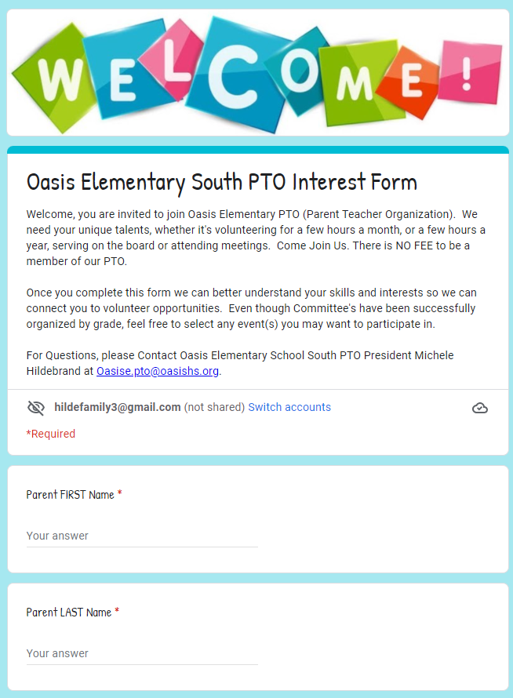
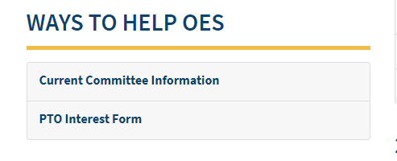
Committee Leads
On the PTO Rocks:

Slide 31
Committee Leads
We plan to continue to have our "Family Fun" Events organized by different grade levels. Please consider getting involved!
Kindergarten Committee FAMILY FUN EVENT
Timeframe: Spring
Members: Yosniel Vento, Lianet Morejon, Ganna Gaber, Erin Wilson, Stephanie Rochelle, Jami Kolev, Christine Baron
1st Grade Committee FAMILY DANCE
Timeframe: February/March
Members: Autumn Clark, Karoline Fabril, Amanda Rourke, Jelena Cianchetta
2nd Grade Committee Event is BOO HOO BREAKFAST & KINDER WELCOME COMMITTEE
Timeframe: Summer & August
Members: Amanda Rourke, Christine Baron
3rd Grade Committee Event is HOLIDAY EVENT
Timeframe: December
Members: Phoenix Proffitt, Ganna Gaber, Amanda Rourke, Stephanie Rochelle, Christine Baron
4th Grade Committee Event is TRUNK OR TREAT
Timeframe: October
Members: Mara Brown & Lindsey Zimmerman
5th Grade Committee Event is the MOVING UP PARTY
Timeframe: May/June
Members: Heather Dinkle, Sam Richardson, Janielle Marrero

