Slide 1

Oasis Elementary
SAC Meeting
September 12, 2018

Slide 2

17-18 School Grade
ELA Achievement | ELA Learning Gains | ELA Learning Gains of the Lowest 25% | Math Achievement | Math Learning Gains | Math Learning Gains of the Lowest 25% | Science Achievement | Total Points
75 | 63 | 62 | 79 | 67 | 58 | 68 | 472

Slide 3
Math
Year | Achievement | LG | L25
2017-2018 | 79 | 67 | 58
2016-2017 | 65 | 49 | 32
2015-2016 | 65 | 47 | 46
2014-2015 | 69

Slide 4
English Language Arts
Year | Achievement | LG | L25
2017-2018 | 75 | 63 | 62
2016-2017 | 72 | 60 | 60
2015-2016 | 72 | 51 | 51
2014-2015 | 72

Slide 5
Science
Year | Achievement
2017-2018 | 68
2016-2017 | 66
2015-2016 | 67
2014-2015 | 71

Slide 6
2018-2019 Goals
Science
  Increase Proficiency by 2%
    From 68 to 70
ELA
  Increase Proficiency by 2%
    From 75 to 77
  Increase Learning Gains by 2%
    From 63 to 65
  Increase L25 Learning Gains by 3%
    From 39-42

Slide 7
2018-2019 Goals
Math
  Increase Proficiency by 2%
    From 79 to 81
  Increase Learning Gains by 2%
    From 67 to 69
  Increase L25 Learning Gains by 3%
    From 68 to 71

Slide 8
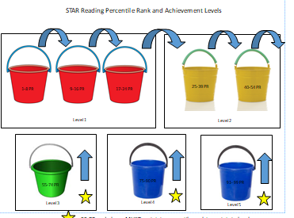
STAR/FSA ELA Buckets

Slide 9
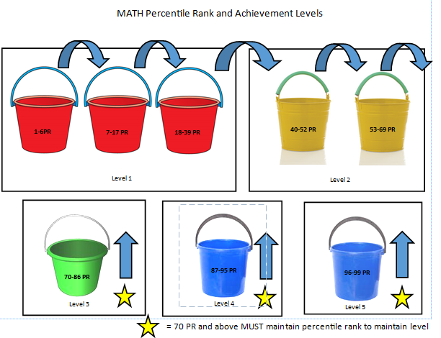
STAR/FSA Math Buckets

Slide 10
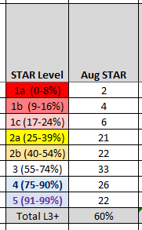

Baseline Data-Grade 01
STAR RDG STARMath MATH

Slide 11
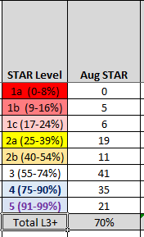
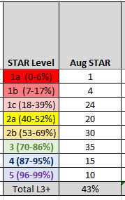
Baseline Data-Grade 02
STAR RDG STAR MATH

Slide 12
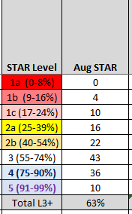
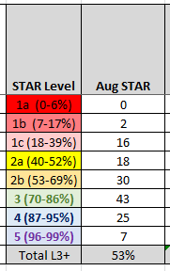
Baseline Data-Grade 03
STAR RDG STAR MATH

Slide 13
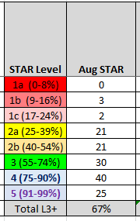
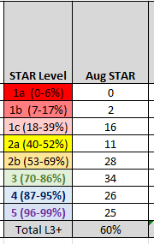
Baseline Data-Grade 04
STAR RDG STAR MATH

Slide 14
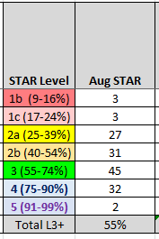
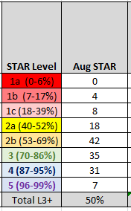
Baseline Data-Grade 05
STAR RDG STAR MATH

Slide 15
Implementation Plan
Purchase and Provide Professional Development for:
  STAR Custom
  Accelerated Math
Instructional Coaching:
  Understanding the STAR test “buckets” or sub groups
  Understanding how to use STAR Instructional Plans

Slide 16
Implementation Plan
Mastery/Enrichment (ME) Time
  40 minutes every day
    To immediately remediate (as needed) standards taught that day or during the week
    To provide creative/enrichment time for students who have mastered the standards
    All students will be provided instruction or skills practice from their STAR Instructional Plan
Progress Monitoring
  Data Chats with teachers and students

Slide 17
Implementation Plan
Lowest 25%
  Cooperative Classrooms
    Resource Teacher
    Paraprofessional
    ME Time
      Special Area Teachers push in

